Slide 1
Teacher, Learner, the Ummah: Reaching for Excellence in Teaching & Learning in the 21st Century
This work is licensed under a Creative Commons Attribution-NonCommercial 4.0 International License.

Slide 2
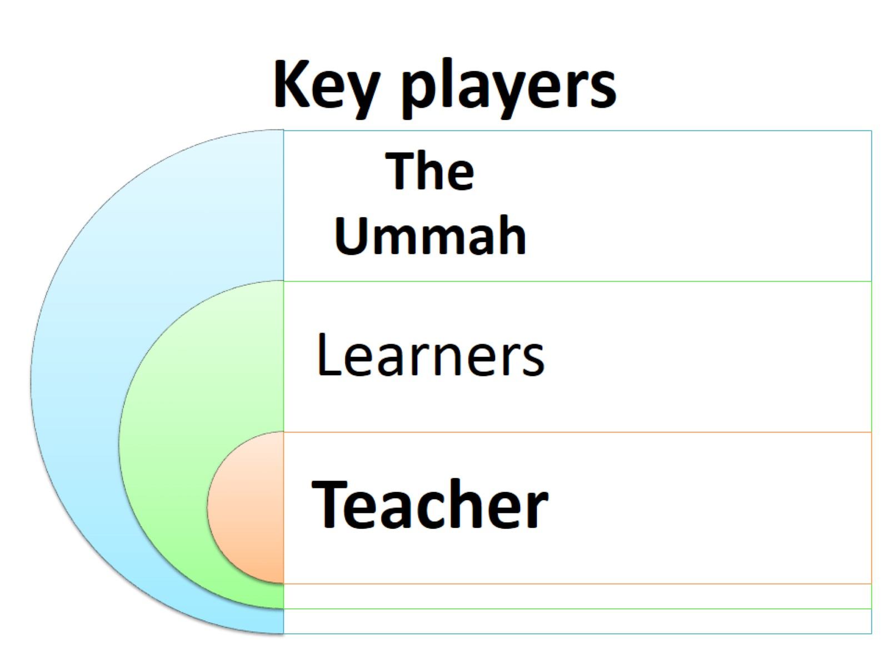
Key players

Slide 3
PREMISE of DISCUSSION

Slide 4
The TEACHER

Slide 5
PASSION IN TEACHING & LEARNING:

Slide 6
What is passion?

Slide 7
Passion = being in the element

Slide 8
What is passion?

Slide 9
Passion = being in the element

Slide 10
What about in the classroom?

Slide 11
Learning Quality = Teacher’s passion

Slide 12
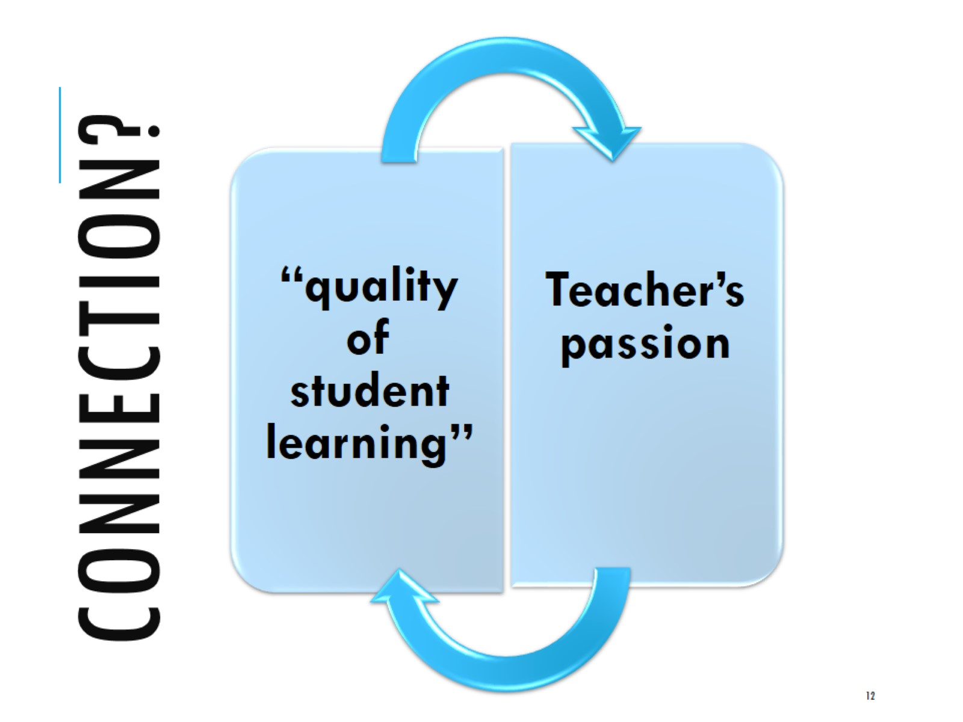
Connection?

Slide 13
MY PERSONAL JOURNEY AS A TEACHER

Slide 14
Milestones in my career path

Slide 15
Conventional 2L + 1T approach from 1995-2012

Slide 16
My state of mind in dec 2012

Slide 17
What’s a passionate teacher?

Slide 18
Initial study

Slide 19
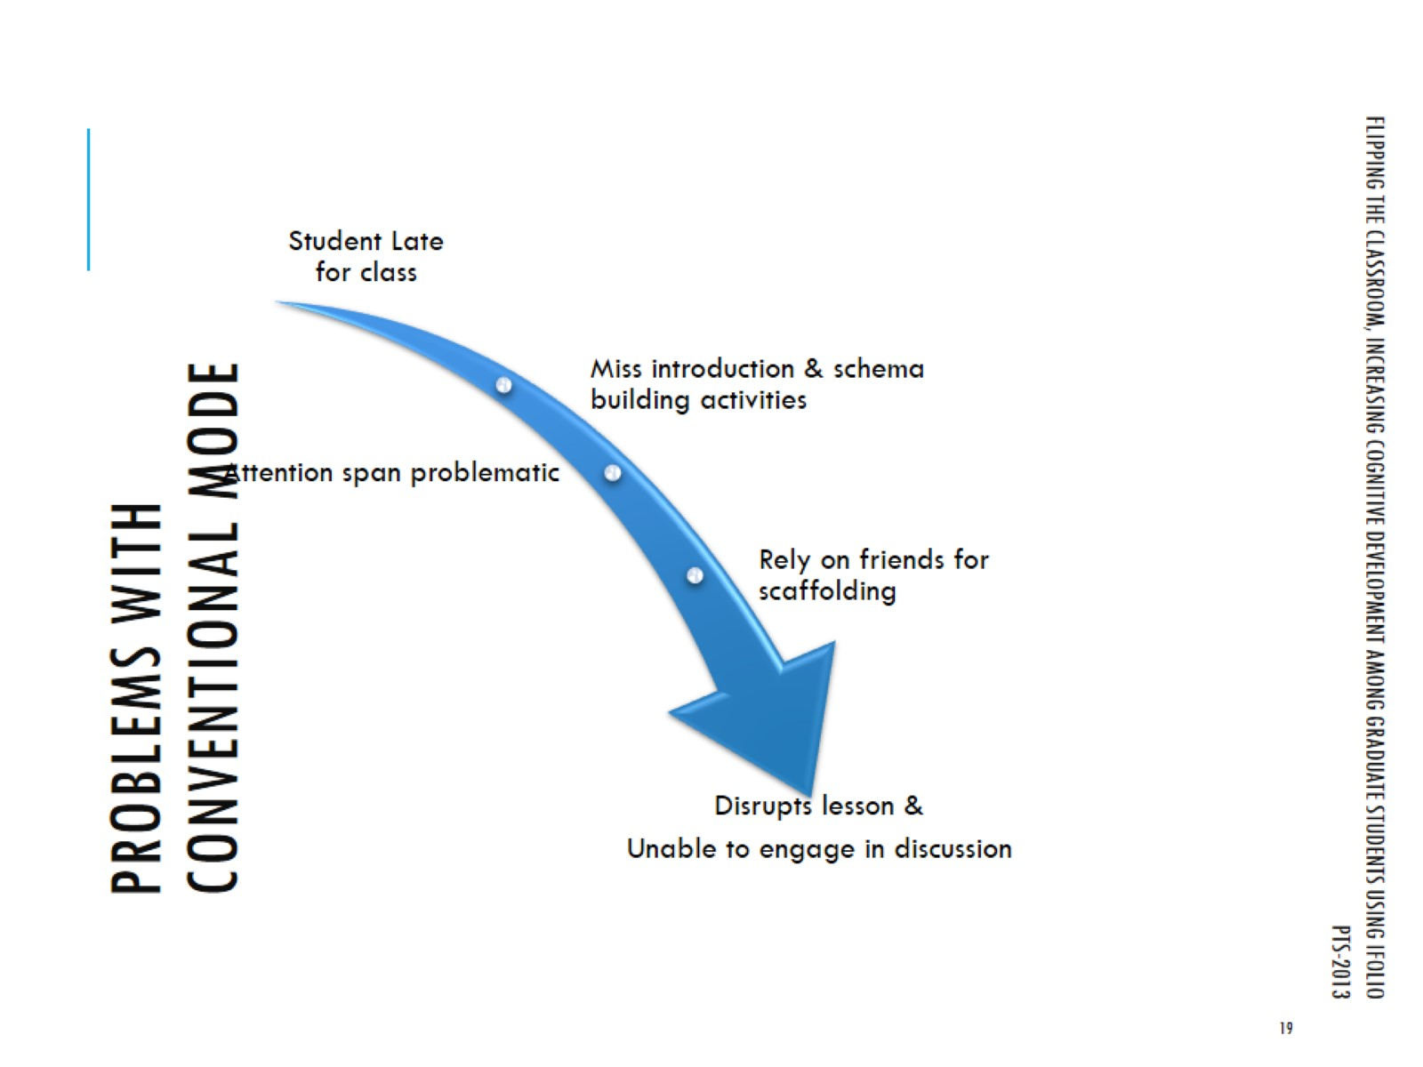
Problems with conventional mode

Slide 20
Problems encountered using conventional 1L+2T method

Slide 21
Literature on teaching & learning shows that….

Slide 22
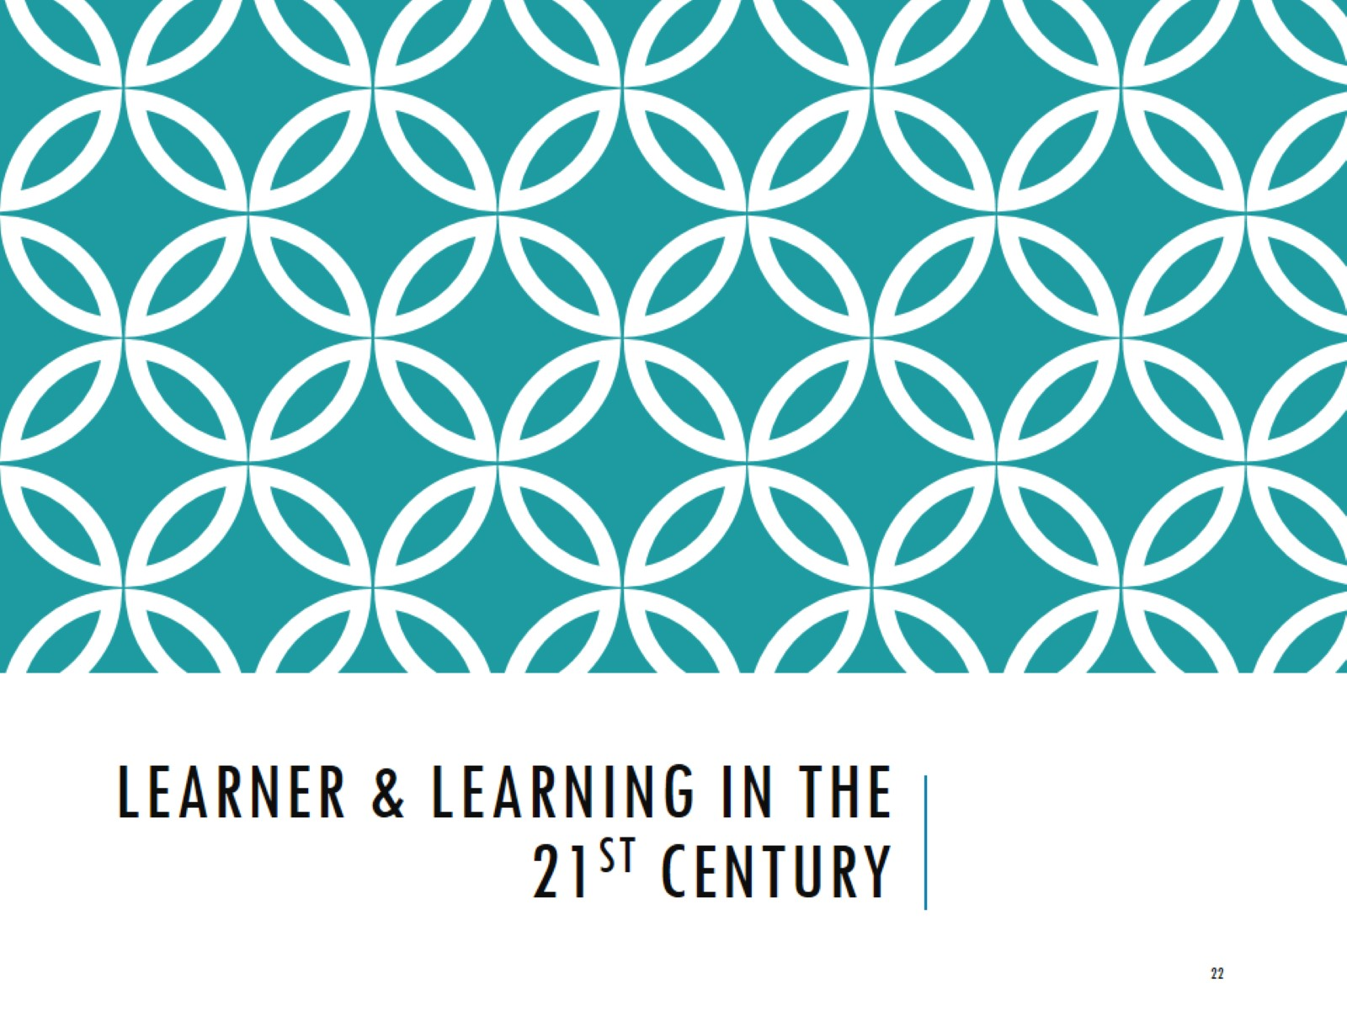
Learner & Learning in the 21st century

Slide 23
Learner’s engagement in my courses from 1995-2012

Slide 24
Literature on Learners of the 21st century: the digital natives

Slide 25
Teringat Kata-kata hikmah

Slide 26
Literature on learners of 21st century vs educators of 20th century

Slide 27
Current state of affairs in Malaysian university

Slide 28
What are the pieces of the education pie?

Slide 29
Can we be passionate and disregard technology?

Slide 30
How should we approach teaching in the 21st century ? My personal response

Slide 32
MY TAKE IS THIS.

Slide 33
IN CONCLUSION: my take ON Scholarship of T & L (Sotl)

Slide 34
Embrace reflective teaching: “working out ideas in action”

Slide 35
Concluding remark

Slide 36
Take home message for all teachers

Slide 37
How to be a passionate teacher?

Slide 38
Syukran jazilan

